Slide 1
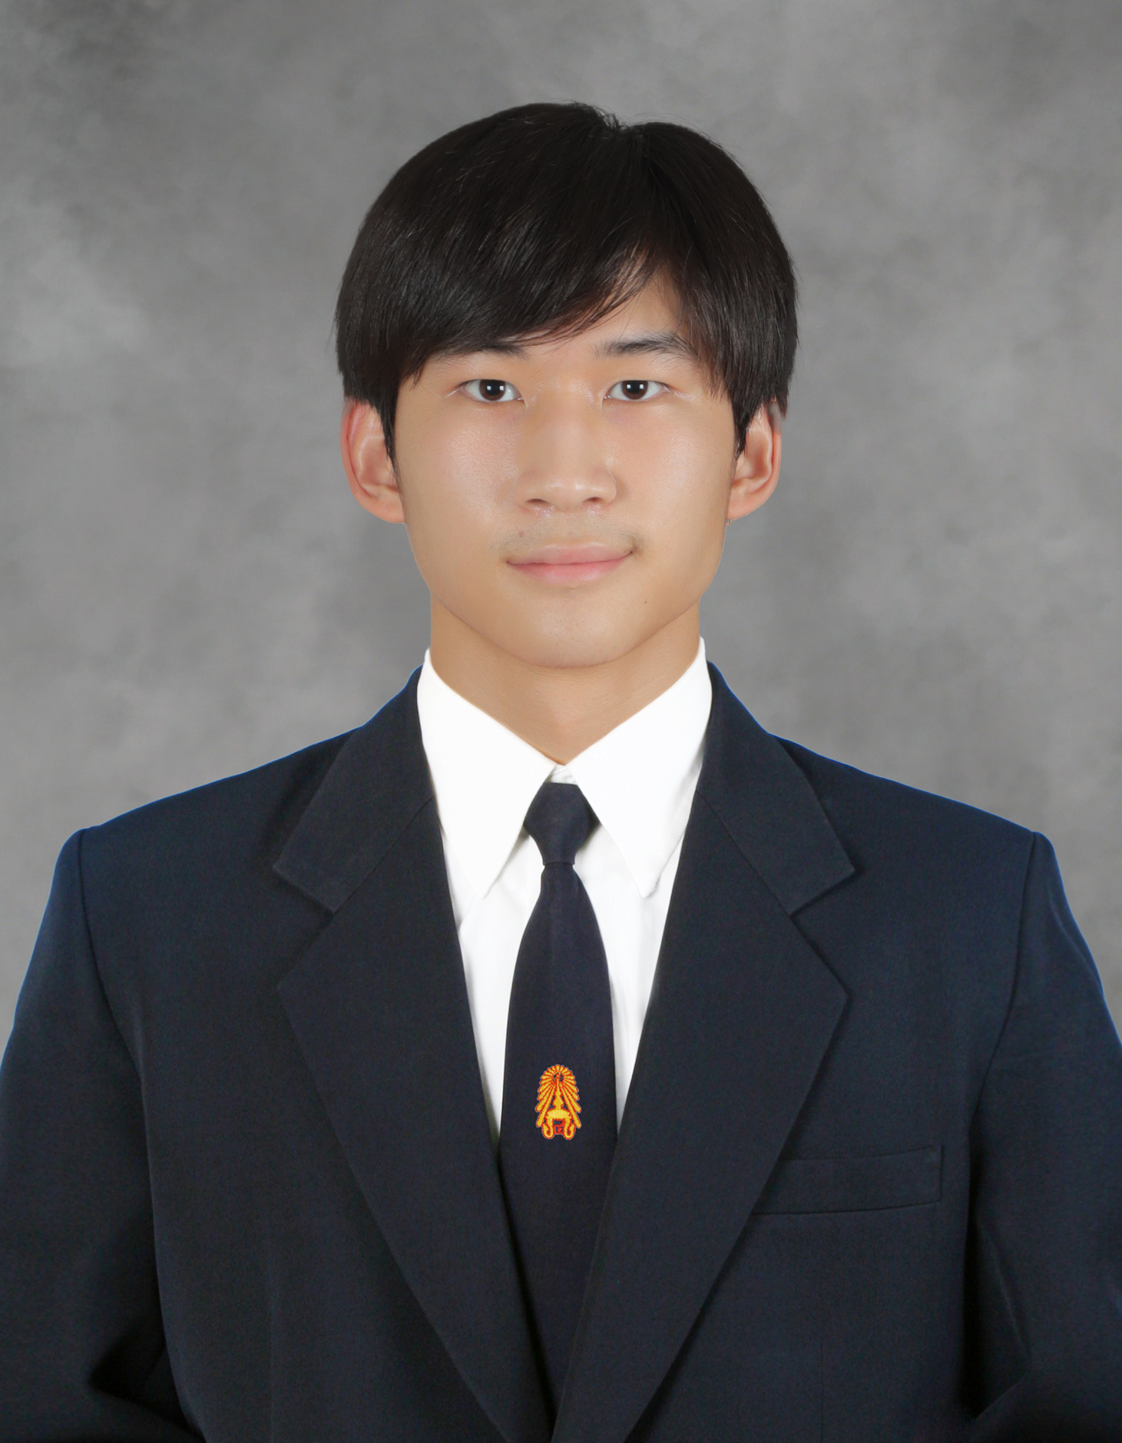
PORTFOLIO
PATIHARN LIANGKOBKIT
King mongkut’s University of Technology Thonburi

Slide 2
Introduction
Hello, my name is Patiharn Liangkobkit, a third-year student at King Mongkut’s University of Technology Thonburi. I am in the Faculty of Engineering, majoring in Computer Engineering.
I have experience in website development (Next.js, HTML, JS, TS, MongoDB, PostgreSQL), game development (Unity, C#), UX/UI design (Figma), hardware development (PCB – Ergogen v4, Arduino, C, 3D printing, laser cutting, and CNC), and AI engineering (YOLOv11 and Python).
I value the principle of Outcome-Based Education (OBE) and the Outcome-Based Approach, which in my view means working on every project with the desire to achieve the best outcomes for users—while ensuring the work aligns with rules and respects human rights.
My work ethic is to complete my work with honesty and consistency. As a hard worker, I usually start working early on any project with full effort. When the project is completed ahead of the deadline, I often revisit it and make improvements if possible. Furthermore, in every project, I value real-world usability. During the brainstorming process, if something doesn’t match real-world use, I try to consult and find the best solution for the project.
My best problem-solving skill is my thinking process, which allows me to understand real-world problems—partly because I am also an entrepreneur. I’m also good at working with people, thanks to my experience leading in churches.
The purpose of this portfolio is to help you better understand me through my working experiences. It is meant to showcase my collaborative skills, development skills, and more. These selected works reflect my capabilities and growth.
Hope you enjoy this portfolio.
Best regards,
Patiharn Liangkobkit

Slide 3
Profile
3
Sample of Work
4-7
Education
8
Table of Contents
Awards
9
Activities
10-17
Certificates
18-21

Slide 4
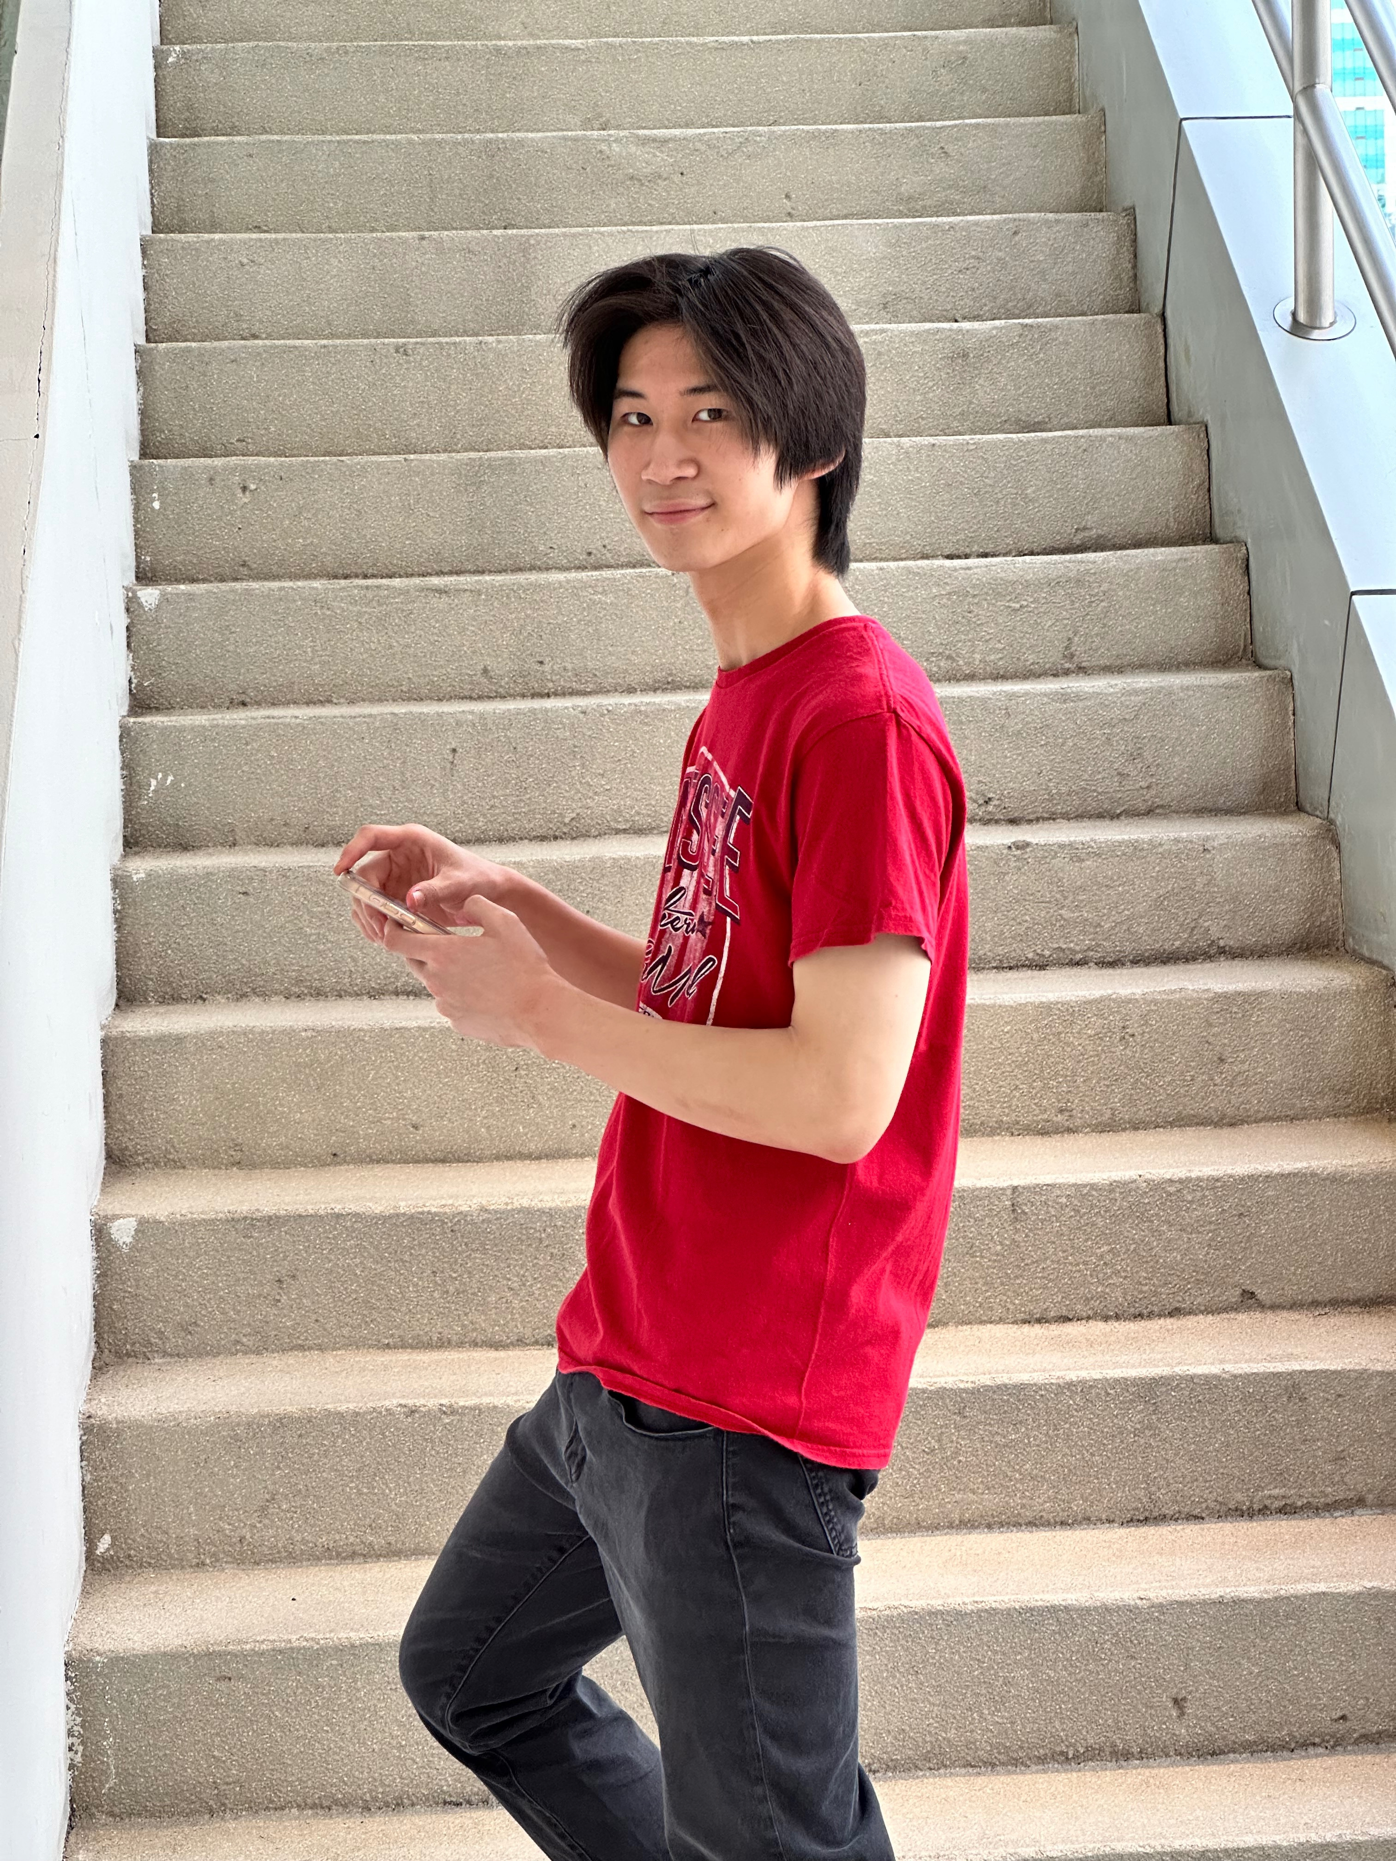
3
Profile
Technical skills
Personal Information
Coding
Typescript
Tailwind CSS
C
React-Native
MySQL
Mongo DB
PostgreSQL
UX/UI
Figma
Adobe Illustrator
Others
Adobe Premiere Pro
Capcut
Name: Patiharn Liangkobkit
Nickname: Richy
Date of Birth: January 27, 2005
Age: 20 years old
Nationality: Thai
Ethnicity: Thai
Religion: Christian
Phone Number: 063-614-5491
Education Level: 3rd-year university student
University: King Mongkut’s University of Technology Thonburi
Student ID: 66070503489
Address: 11/165 Nirvana Sathorn,
Kanlapaphruek Road, Bang Khun Thian Subdistrict,
Chom Thong District, Bangkok 10150
Email: richyboy170@gmail.com , patiharn.lian@mail.kmutt.ac.th

Slide 5
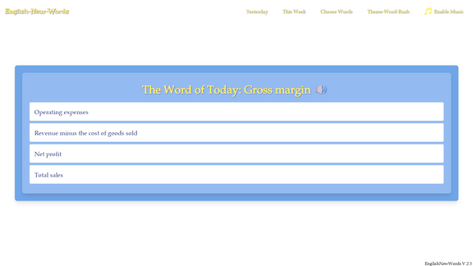
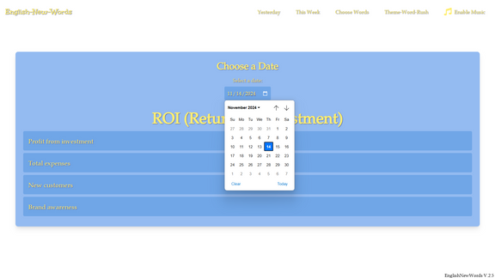
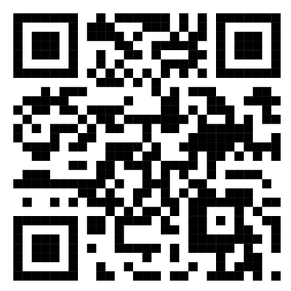
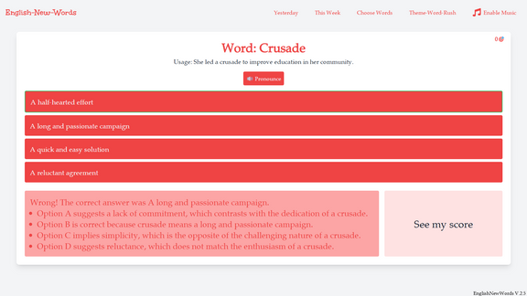
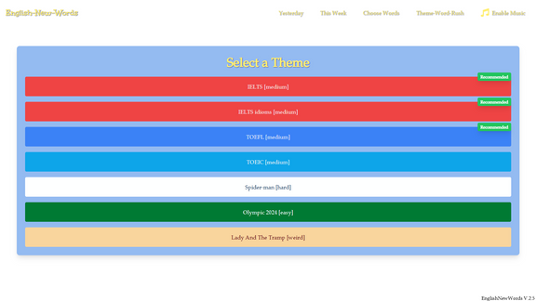
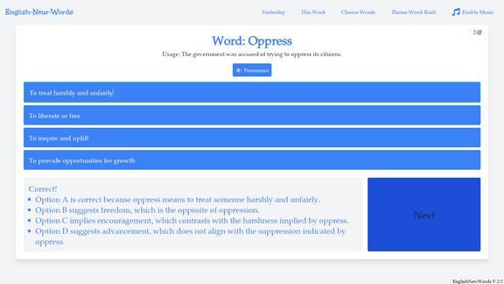
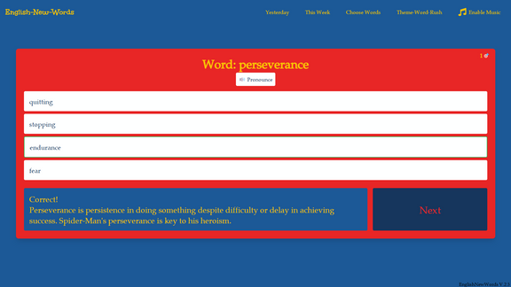
4
SAMPLE OF WORK
ENGLISHNEWWORDS.VERCEL.APP WEBSITE
This is one of my most impactful personal projects; EnglishNewWords.vercel.app, a website that helps individuals learn new vocabulary daily through interactive mini-games. Built primarily with TypeScript on Next.js, the platform has been running since July 8, 2024.

Slide 6
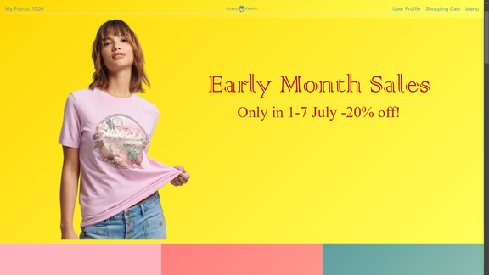
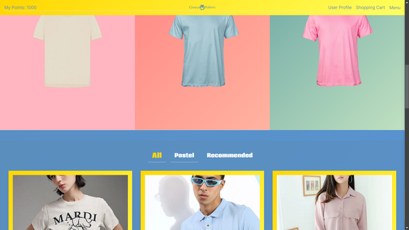
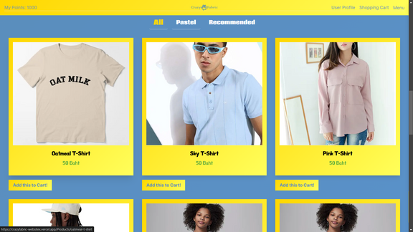
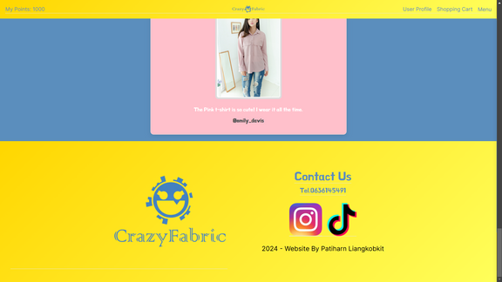
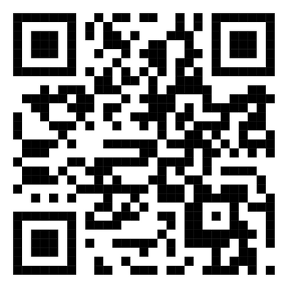
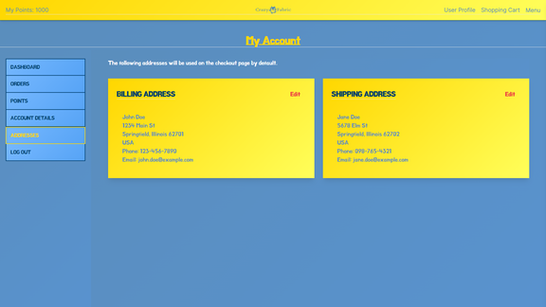
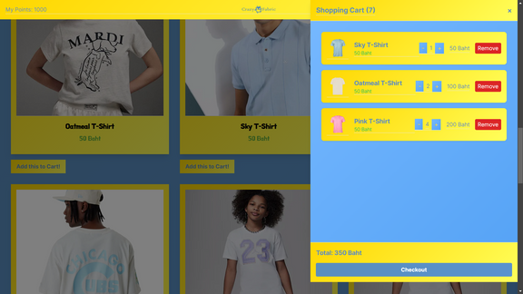
5
SAMPLE OF WORK
CRAZYFABRIC-WEBSITEX.VERCEL.APP WEBSITE
Crazyfabric-websitex.vercel.app is a website including mostly front-end for displaying t-shirts, testimonials, and structure for further improvement on dashboard, orders, points, account details, and addresses.

Slide 7
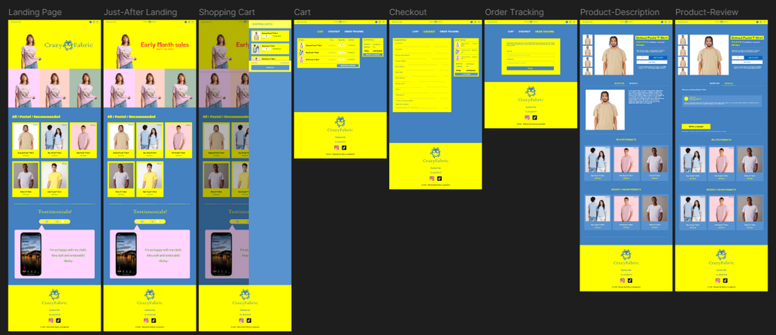
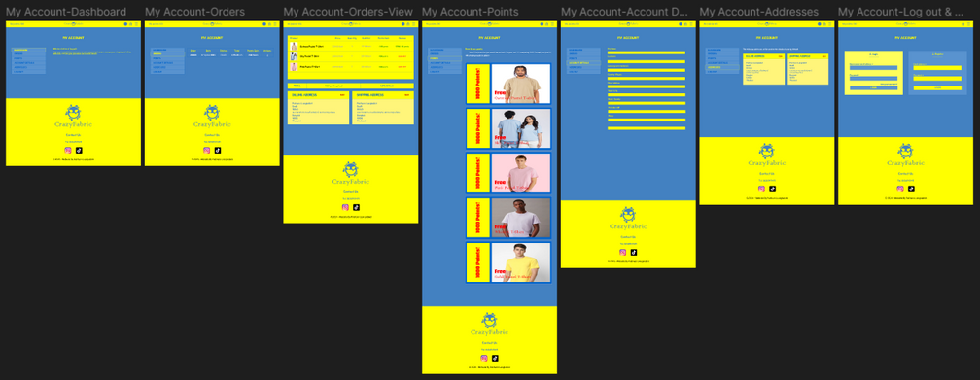
6
CRAZYFABRIC-WEBSITEX.VERCEL.APP WEBSITE
SAMPLE OF WORK
DESIGNED GUIDELINE ON FIGMA
Crazyfabric-websitex.vercel.app is a website including mostly front-end for displaying t-shirts, testimonials, and structure for further improvement on dashboard, orders, points, account details, and addresses.

Slide 8
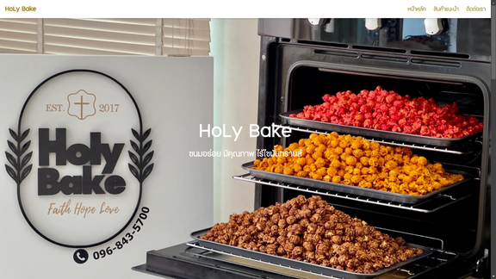
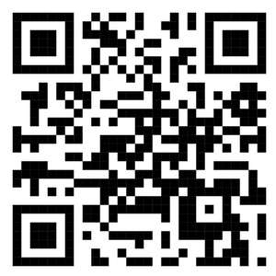
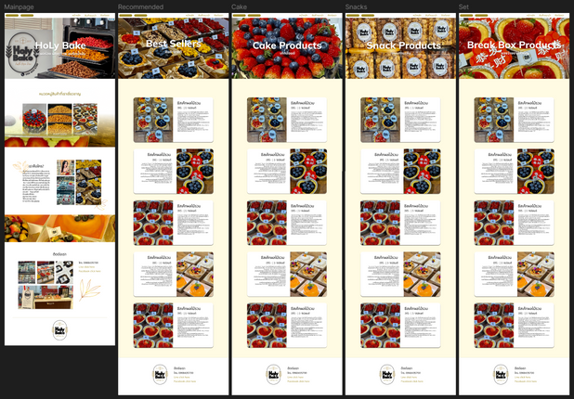
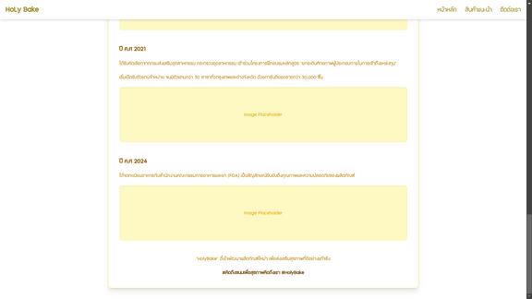
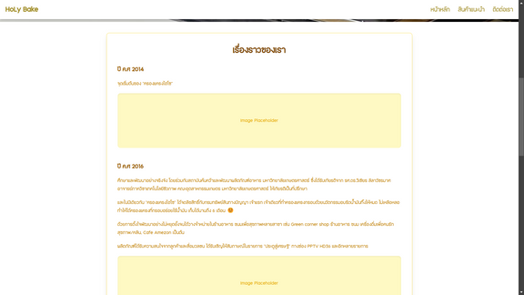
7
SAMPLE OF WORK
HOLYBAKE.VERCEL.APP WEBSITE
DESIGNED GUIDELINE ON FIGMA
Holybake.vercel.app is a website I designed and developed for HoLy Bake, a homemade baking business. It showcases the brand's story and highlights its products through an engaging and visually appealing interface.

Slide 9


8
Education
High School
Bangkok Christian College
Graduated with a Grade 12 cumulative GPA of 3.85
University
King Mongkut’s University of Technology Thonburi
– Bachelor of Engineering in Computer Engineering
Year 1, Semester 1: GPA 3.77
Year 1, Semester 2: GPA 3.69
Year 2, Semester 1: GPA 3.76
Year 2, Semester 2: GPA 3.66
Current Cumulative GPAX: 3.72
Education

Slide 10
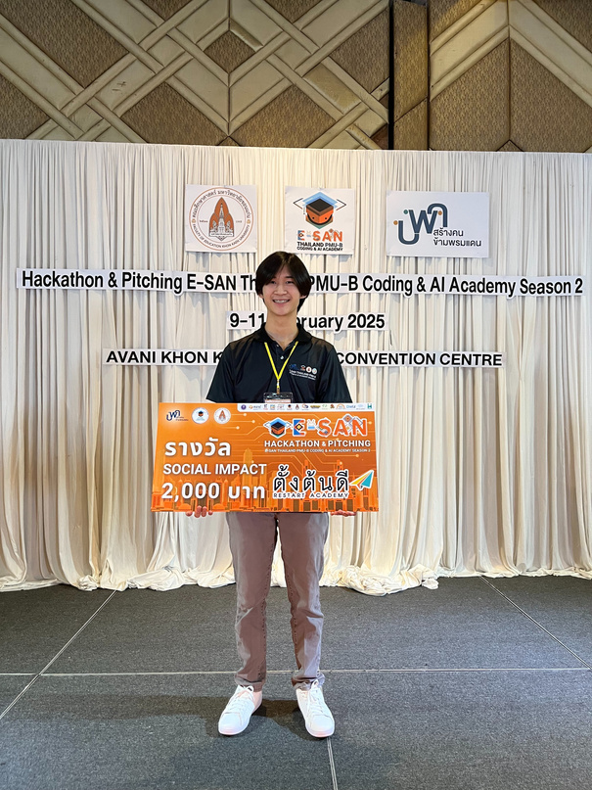
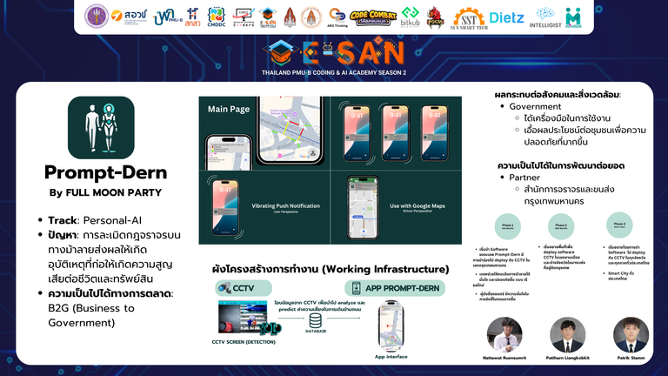
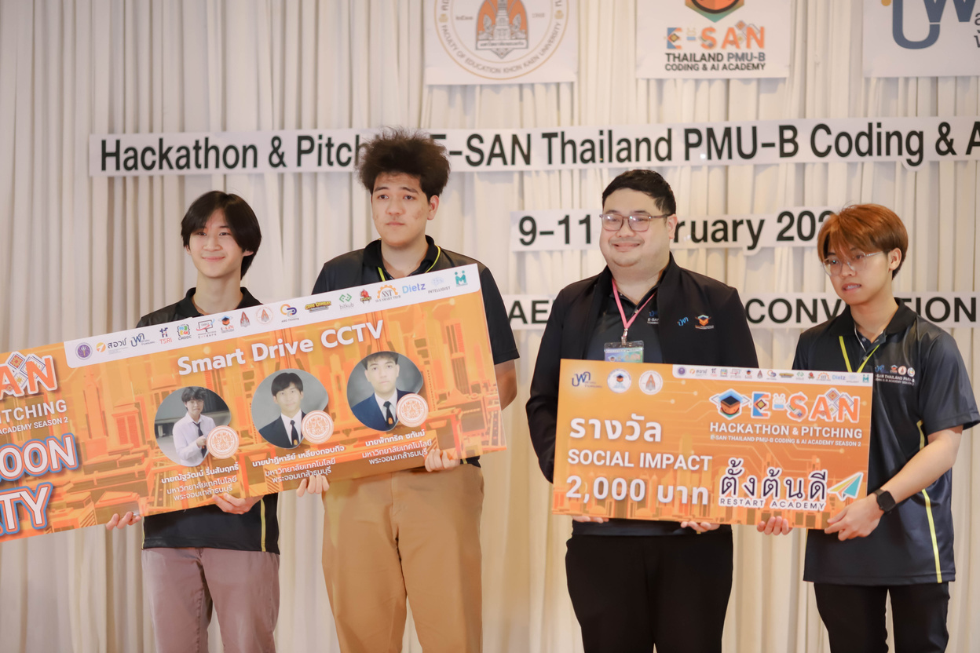
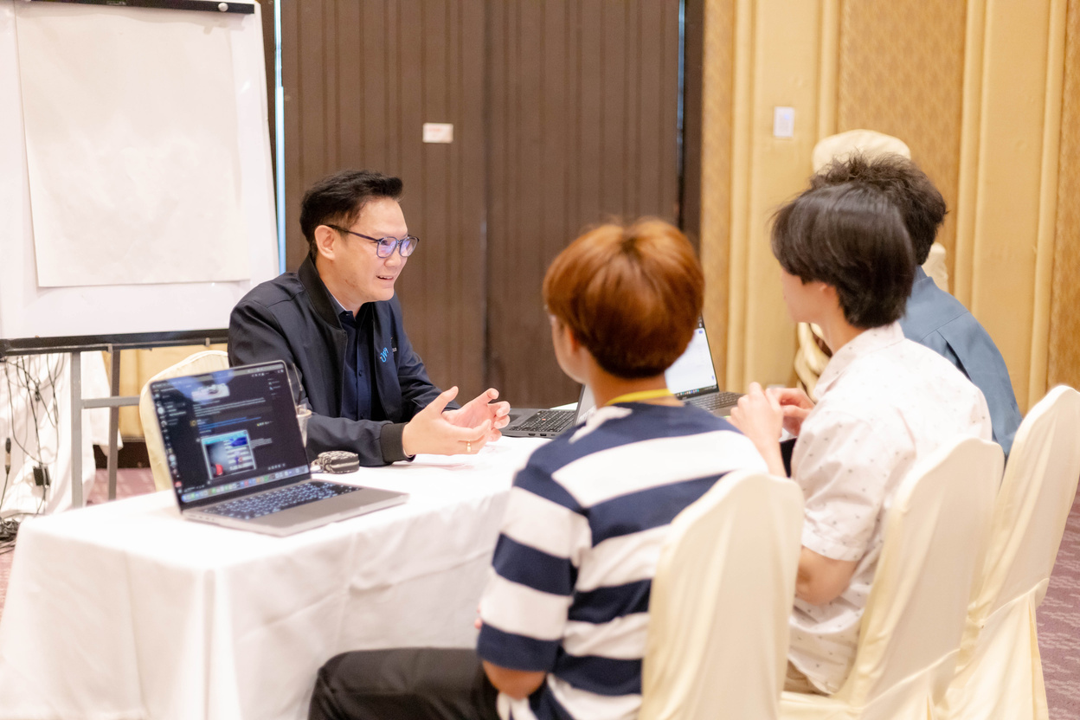
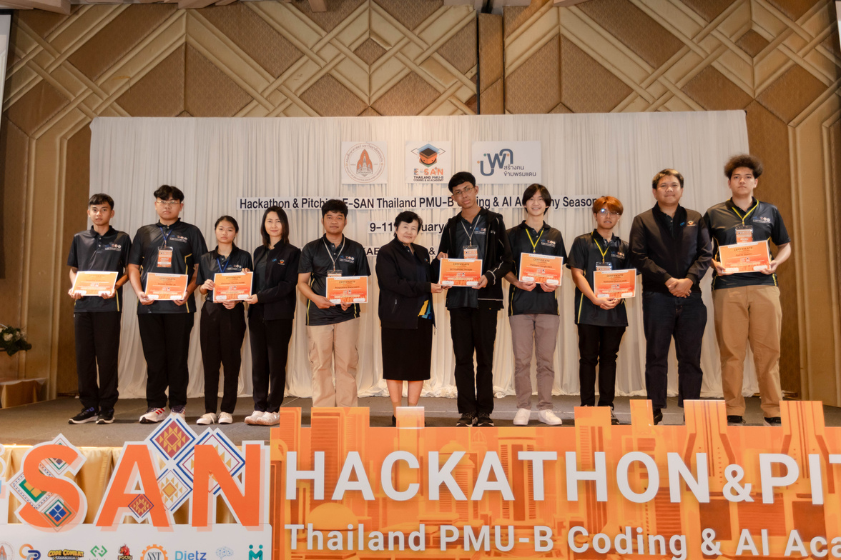
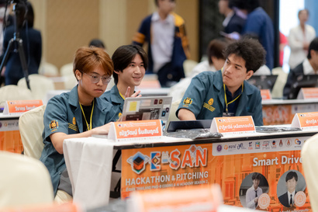
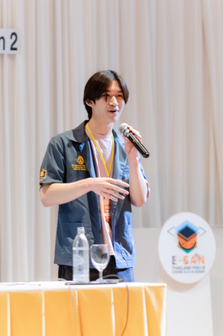
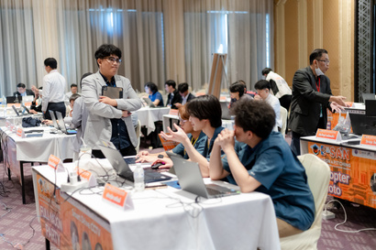
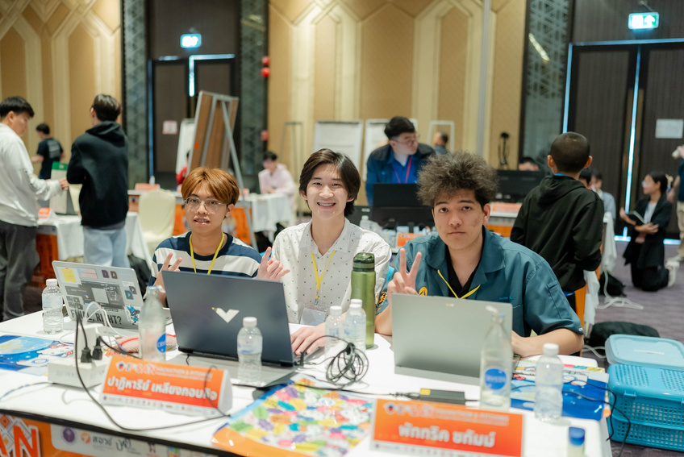
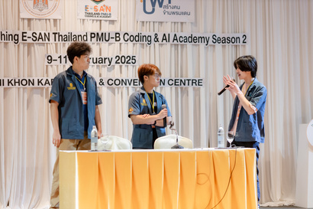
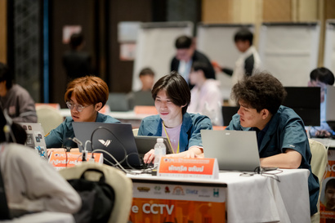
9
AWARDS
E-SAN Thailand PMU-B Coding & AI Academy Season 2
I was selected for the final round of the Hackathon & Pitching (E-SAN Thailand PMU-B Coding & AI Academy Season 2) from 1,076 participants across Thailand. As part of a 20-team competition, we won the Social Impact Prize for the Smart Drive CCTV project, which detects road-crossing dangers using AI with YOLOv11 and Python.

Slide 11
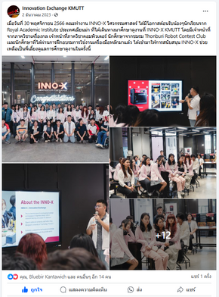
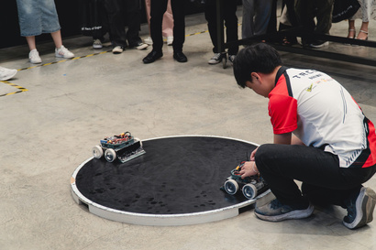
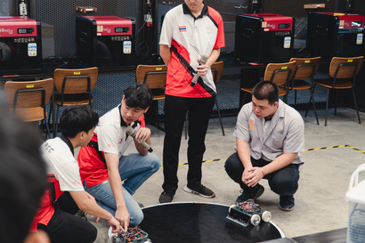
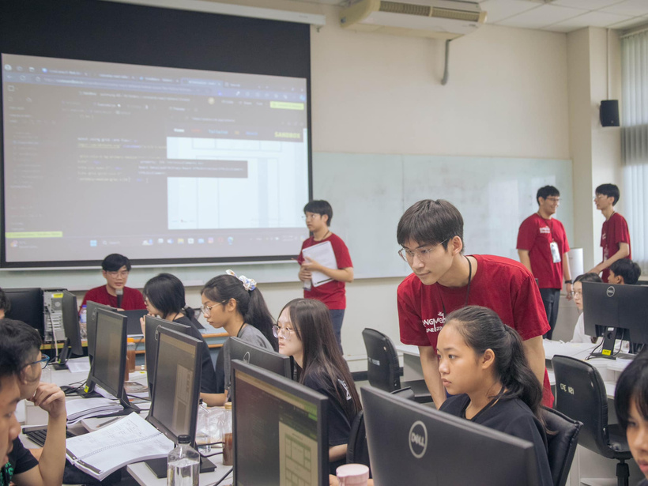
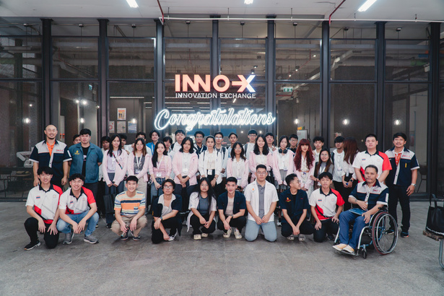
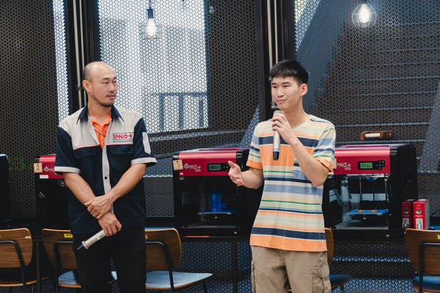
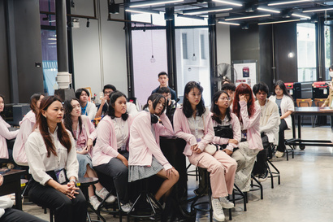
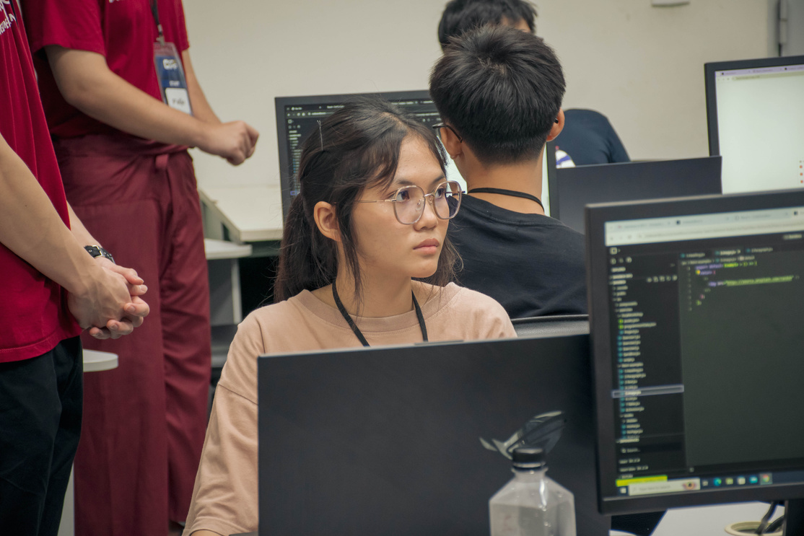
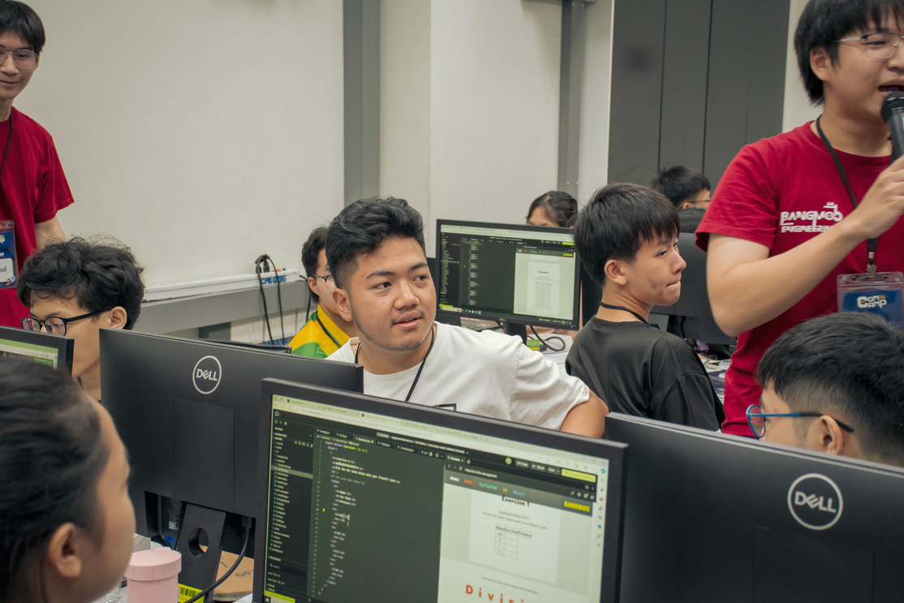
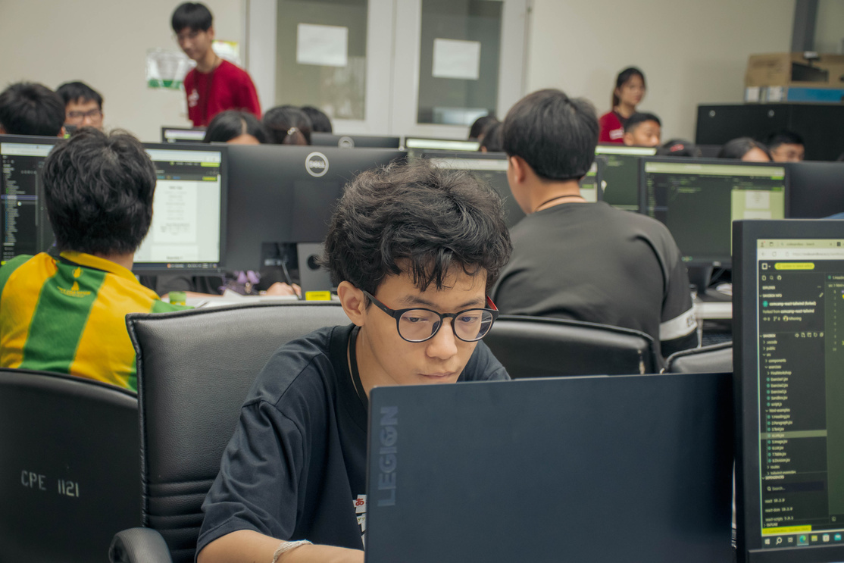
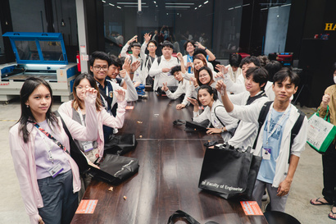
10
Activities
I had the opportunity to serve as a Teacher Assistant in the Web Development class at Comcamp 2024. The main topic was website design using React, with subtopics including JavaScript, Tailwind CSS, and HTML.
I had the opportunity to serve as a translator, assisting a professor in translating Thai to English during the Innovation Exchange at KMUTT for students from the Royal Academic Institute, Myanmar, on November 30, 2023.

Slide 12
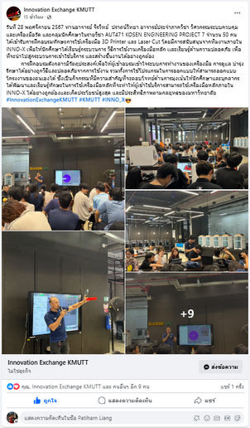
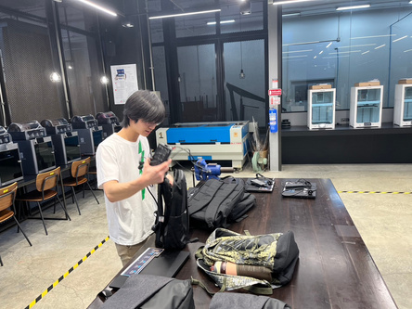
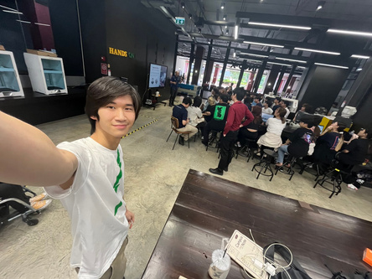
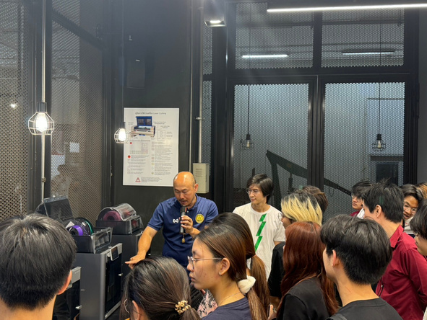
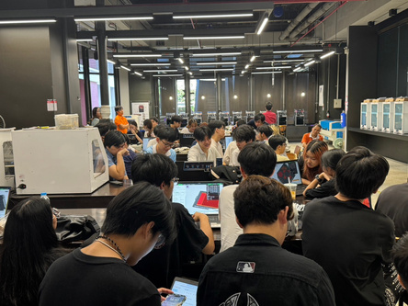

11
Activities
I had the opportunity to be a Teacher Assistant during the Innovation Exchange at KMUTT on November 28, 2024, supporting around 50 students from the Control and Instrumentation Engineering Department and the AUT471 KOSEN Engineering Project 7 course. I assisted in training students on how to use 3D printers and laser cutting tools.

Slide 13





















12
Activities
I had the opportunity to establish a fried chicken business, with the help of my family, called “Chicken Knight” with the goal of supporting my family’s income. I was involved in every aspect of the process—from concept development, branding, and menu creation to customer service and daily operations. This experience not only helped strengthen our financial stability but also taught me valuable skills in entrepreneurship, time management, and customer engagement.

Slide 14
















13
Posters created
GrabFood
Lineman
I also created and managed official accounts for Lineman and GrabFood, allowing Chicken Knight to reach a wider audience through popular food delivery platforms. This helped boost visibility, increase sales, and streamline the ordering process for customers.

Slide 15
























14
Activities
I have been actively involved in church life for over 20 years, regularly attending services and participating in various ministries. I serve on the worship team, contributing as a bassist, guitarist, violinist, singer, and occasionally as a worship leader. Over the years, I have also participated in numerous church camps and spiritual retreats, which have helped strengthen both my faith and leadership skills.

Slide 16








15
Activities
I submitted my work to the Gunpla Builders World Cup in Thailand in 2018, 2019, and 2024.
I had an opportunity to volunteer for 5 hours at First Baptist Church, Henderson, helping distribute food to people in need.

Slide 17








16
Participated in a one-year exchange program in the United States during the 2021–2022 academic year.
Served as a stagehand in the school’s theatre club and received the Workhorse Award at the Theatre Banquet 2022.
Activities

Slide 18















17
Activities
Served as a camp committee member for the "Pramuan Mitr Christian Once Again 2022" high school club camp.
Volunteered in the Historical Archives Department during Bangkok Christian College’s 170th Anniversary Celebration (BCC170).
Participated in a training program for industrial engineers organized by SIIT (Sirindhorn International Institute of Technology).

Slide 19








18
Certificates
COMPUTER SCIENCE AND BUSINESS
E-SAN CODING AND AI HACKATHON
E-SAN CODING AND AI HACKATHON
E-SAN CODING AND AI HACKATHON
ACA ALIBABA CLOUD HANDS-ON
E-SAN THAILAND CODING & AI ACADEMY
IN 2025
E-SAN THAILAND CODING & AI ACADEMY
IN 2025
E-SAN THAILAND CODING & AI ACADEMY
IN 2024
ALIBABA CLOUD IN 2024
INTERNATIONAL PATTERN DESIGN CONTEST
BUSINESS PLAN COMPETITION
COMPUTER SCIENCE CERTIFICATION
OPERATION MANAGEMENT GAME
KMUTT IN 2024
KMUTT IN 2024
CODE COMBAT IN 2024
SIIT THAMMASAT UNIVERSITY IN 2022

Slide 20







19
Certificates
COMPUTER SCIENCE AND BUSINESS
GAUSSIAN MIXTURE MODEL COURSE
NLP CLASSIFICATION COURSE
YOLO V.8 COURSE CERTIFICATION
CODE2VEC COURSE
POWERCLASS.ORG IN 2024
POWERCLASS.ORG IN 2024
POWERCLASS.ORG IN 2024
POWERCLASS.ORG IN 2024
1D CNN COURSE
IMAGE CLASSIFICATION COURSE CERTIFICATION
MEDIA DESIGN FOR ADVERTISING
POWERCLASS.ORG IN 2024
POWERCLASS.ORG IN 2024
KMUTT IN 2023

Slide 21








20
Certificates
LANGUAGE AND PERSONALITIES
STUDENT-EXCHANGE PROGRAM IN AMERICA
BCC HISTORY HALL ORGANIZER
READER OF THE YEAR 2019
STUDENT COUNCIL ASSISTING CERTIFICATION
WORANTEX & AYP IN 2022
BANGKOK CHRISTIAN COLLEGE IN 2022
BANGKOK CHRISTIAN COLLEGE IN 2019
BANGKOK CHRISTIAN COLLEGE IN 2020
READER OF THE YEAR 2020
READER OF THE YEAR 2018
STUDENT OF THE MONTH
READING CLUB CERTIFICATION
BANGKOK CHRISTIAN COLLEGE IN 2020
BANGKOK CHRISTIAN COLLEGE IN 2018
BANGKOK CHRISTIAN COLLEGE IN 2016
NANMEEBOOKS IN 2017

Slide 22






21
Certificates
HEALTH AND BELIEF
ACADEMIC EXCELLENCE IN CL218-UNI
YOUNG EVANGELIST CAMP PARTICIPATION
CHRISTIAN CHARACTER DEVELOPMENT CAMP
ALCOHOLIC PREVENTION CERTIFICATION
ACTS OF CHRIST CHURCH IN 2024
YOUTH FIRST CONCERN FOUNDATION (YFC) IN 2023
ACTS OF CHRIST CHURCH IN 2022
Saraburi Wittayakhom School in 2021
BASIC LIFE SUPPORT TRAINING
BOY SCOUT CERTIFICATION
BANGKOK CHRISTIAN HOSPITAL IN 2020
NATIONAL SCOUT ORGANIZATION OF THAILAND IN 2018

